Slide 1
Meta Tags for Social Media

Slide 2
Which sites utilize meta tags?
Facebook
Twitter
Linked In
Pinterest

Slide 3
What are meta tags used for on social?
Provide an engaging visual
Provide a brief description

Slide 4
Facebook
FACEBOOK

Slide 5
Facebook
Uses OG tags (Open Graph)
Full support from Pinterest and Google+
Partial support from Twitter
1200x630 picture
Can’t have spaces in URL
FACEBOOK

Slide 6
Facebook
og:url – Page URL to link to
og:type – Article, Recipe, Video, etc
og:image – Link to image URL
og:title – Page/Article title
og:description – Description below photo (<200 chars)
FACEBOOK

Slide 7
Twitter
Does recognize OG tags
Also uses Twitter Cards
twitter:card - specify image preview size
summary
summary_large_image
player (used for video)
TWITTER

Slide 8
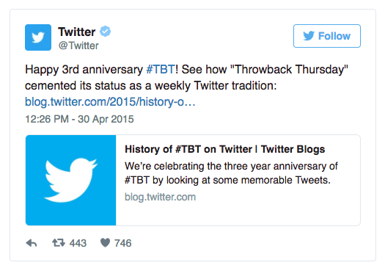

Slide 9
Twitter
twitter:site – Page URL
twitter:title – Page/Article Title
twitter:description – Page description
twitter:image – Image preview
TWITTER

Slide 10
Conclusion
Using meta tags can make transform shared web pages into a rich object on social media platforms
They are separate from meta tags used by Google and other search engines for SEO
TWITTER

